Slide 1
THE 12 MINOR PROPHETS: Jonah
Forgiveness Given To God’s Enemies

Slide 2
THE NATURE OF REPENTANCE
IT’S ALL ABOUT THE HEART
A HEART THAT HAS EYES AND FEET

Slide 3
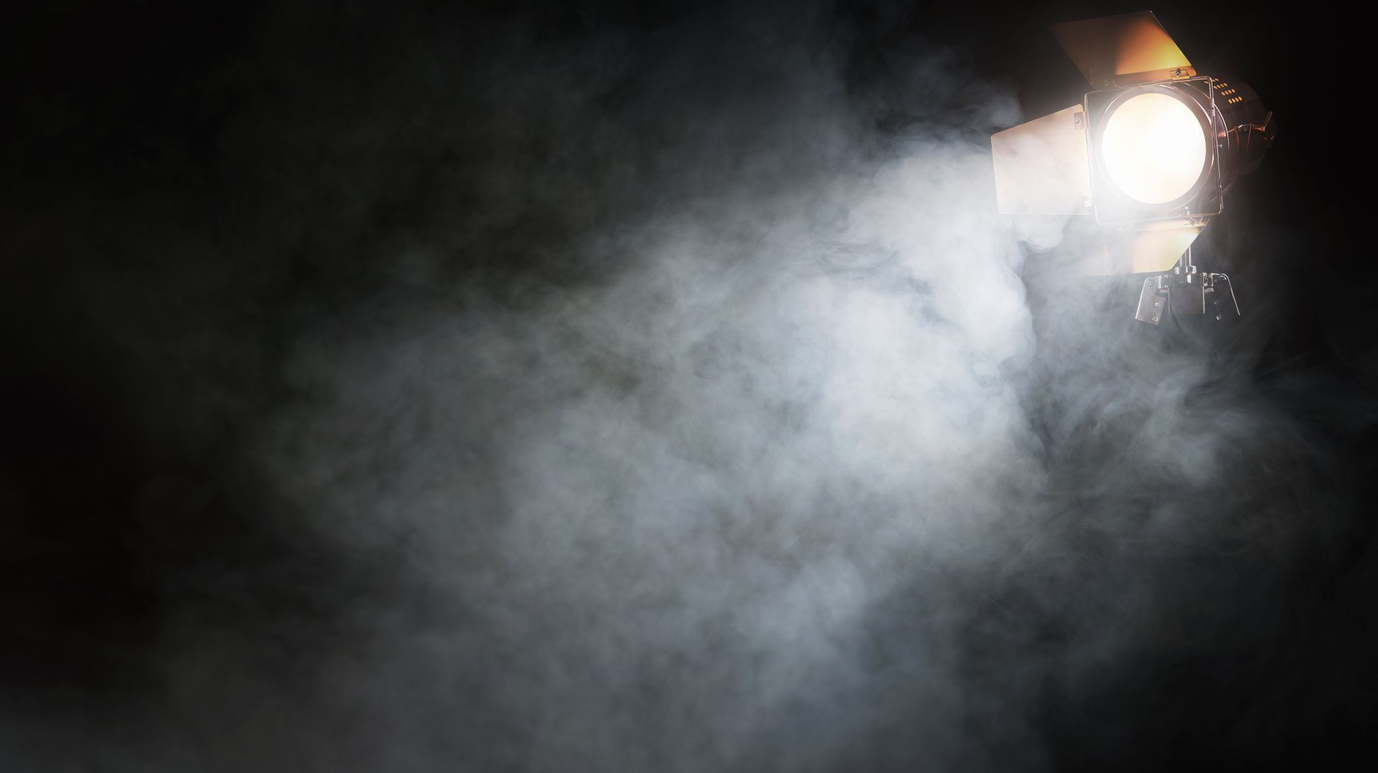
Lets Set The Stage:
Mission Impossible (with man)

Slide 4
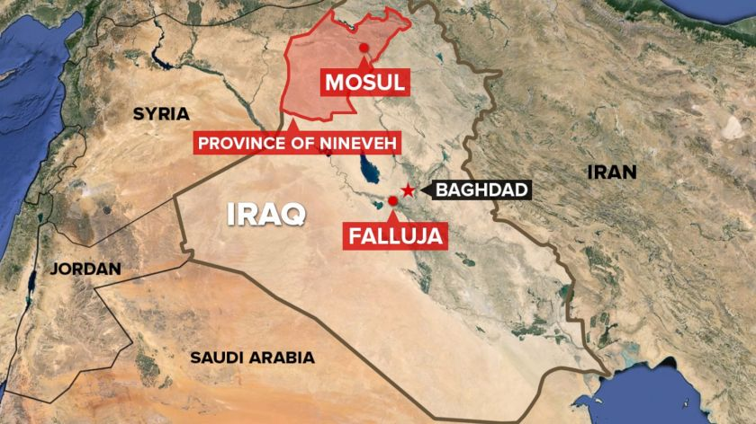

Slide 5
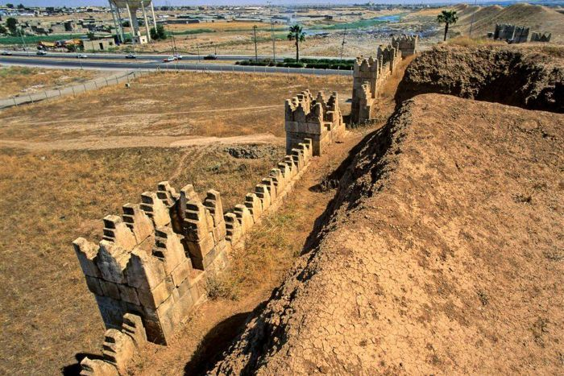

Slide 6
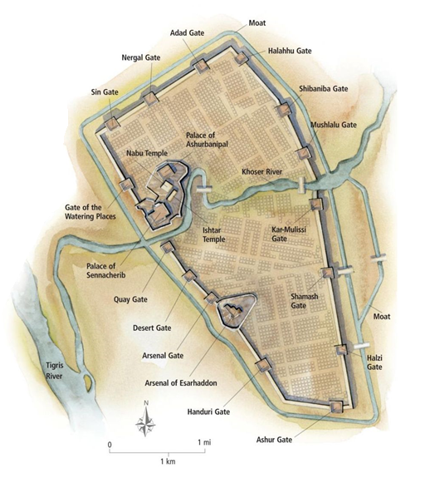

Slide 7
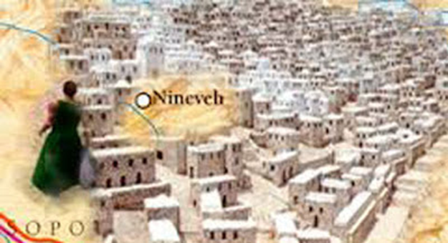

Slide 8
Listen for this:
The Mission, The Message, The Mass Repentance

Slide 9
Jonah 3 (NASB)
1 Now the word of the LORD came to Jonah the second time, saying,
2 “Arise, go to Nineveh, the great city, and proclaim to it the proclamation which I am going to tell you.”

Slide 10
1 Corinthians 15:3
1 Now, brothers and sisters, I want to remind you of the gospel I preached to you, which you received and on which you have taken your stand.
² By this gospel you are saved, if you hold firmly to the word I preached to you. Otherwise, you have believed in vain.
³ For what I received I passed on to you as of first importance: that Christ died for our sins according to the Scriptures,
⁴ that he was buried, that he was raised on the third day according to the Scriptures,

Slide 11
Jonah 3 (NASB)
3 So Jonah got up and went to Nineveh according to the word of the LORD. Now Nineveh was an exceedingly large city, a three days’ walk.
4 Then Jonah began to go through the city one day’s walk; and he cried out and said, “Forty more days, and Nineveh will be overthrown.”

Slide 12
Jonah 3 (NASB)
5 Then the people of Nineveh believed in God; and they called a fast and put on sackcloth, from the greatest to the least of them.

Slide 13
Jonah 3 (NASB)
5 Then the people of Nineveh believed in ELOHIM; and they called a fast and put on sackcloth, from the greatest to the least of them.

Slide 14
Jonah 3 (NASB)
6 When the word reached the king of Nineveh, he got up from his throne, removed his robe from himself, covered himself with sackcloth, and sat on the dust.
7 And he issued a proclamation, and it said, “In Nineveh by the decree of the king and his nobles: No person, animal, herd, or flock is to taste anything. They are not to eat, or drink water.

Slide 15
Jonah 3 (NASB)
8 But every person and animal must be covered with sackcloth; and people are to call on God vehemently, and they are to turn, each one from his evil way, and from the violence which is in their hands.
9 Who knows, God may turn and relent, and turn from His burning anger so that we will not perish.”

Slide 16
Jonah 3 (NASB)
10 When God saw their deeds, that they turned from their evil way, then God relented of the disaster which He had declared He would bring on them. So He did not do it.

